Slide 1




About Me
I am a dedicated and skilled Senior Software Development Engineer with a strong foundation in cloud technologies, underscored by my certification as a Cloud Practitioner.
Professional Snapshot
Full-Stack & MERN Stack Developer
Skilled in building scalable web applications (Frontend + Backend).
Gen AI Developer
Hands-on with AI/ML applications and modern AI tools.
DevOps Engineer (AWS Certified Professional)
Experience in cloud deployment, CI/CD, and automation.
Assistant Professor (Part-Time / Guest Lecturer)
Delivered lectures on Python, Machine Learning, Java and Web Development.
Mentor & Educator
Guided students in coding, projects, and career development.
PRAMOD NAIK
Address: Mangalore, Karnataka.
pramodnaik.dev@gmail.com
+91 9611025113

Slide 2
PRAMOD VISHNU NAIK
Current Position: Software Development Engineer (Full-Stack, MERN stack and Gen AI Developer), MResult Technologies Pvt Ltd.
Educational Qualification: MCA (Specialization in Data Science and Cloud Computing), Srinivas University, Mangalore Certifications: AWS Certified Professional
Experience:
3.5 years of professional experience in software development
Assistant Professor (Guest Lecture and Mentor) with 2 years of teaching experience.
Skills:
Primary Skills: AWS, ML, Node.js, React, Redux Toolkit, TypeScript, Express.js, Python, FastAPI, Flask, SQL, PostgreSQL, MySQL, Java, PHP, DataIKU, Snowflake, Informatica IICS.
PRAMOD NAIK
Address: Mangalore, Karnataka.
+91 9611025113
pramodnaik.dev@gmail.com

Slide 3

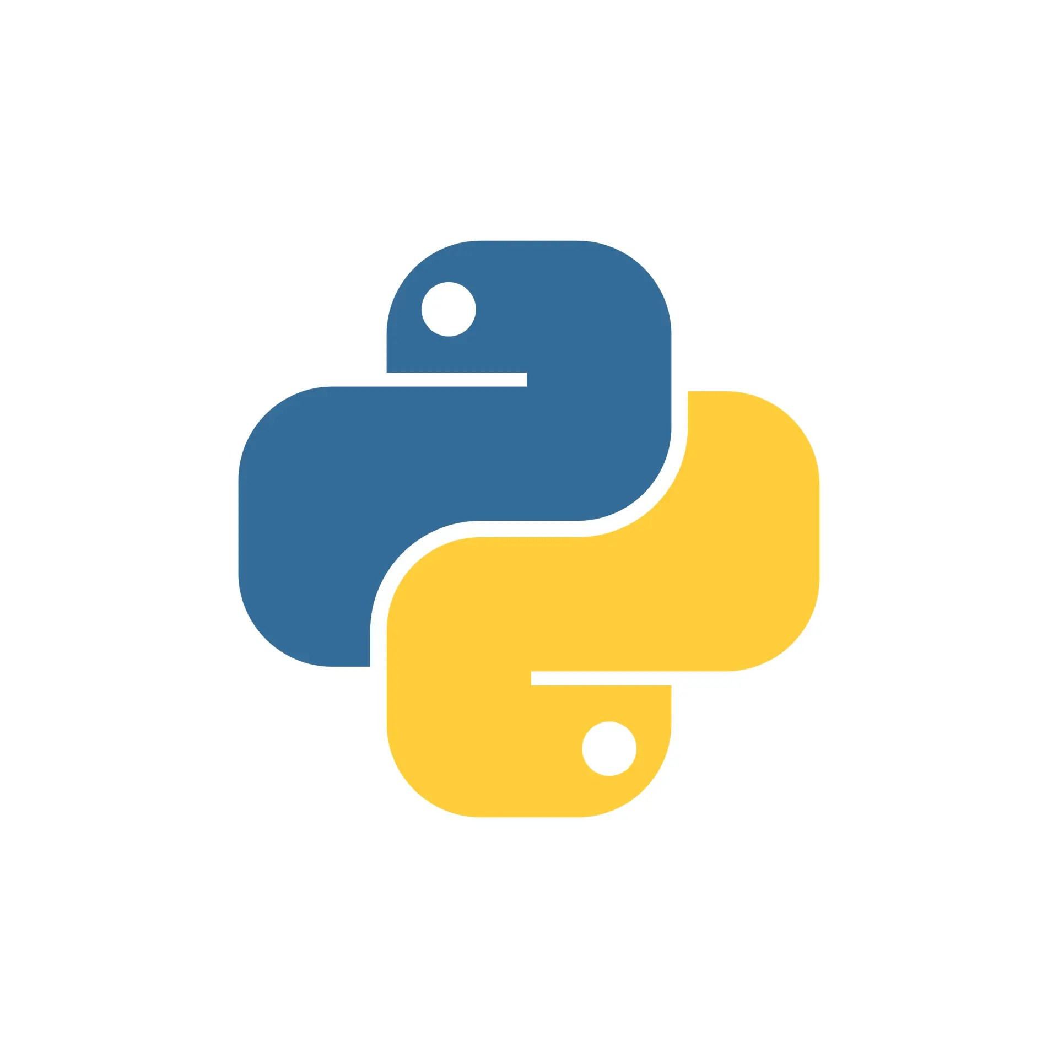
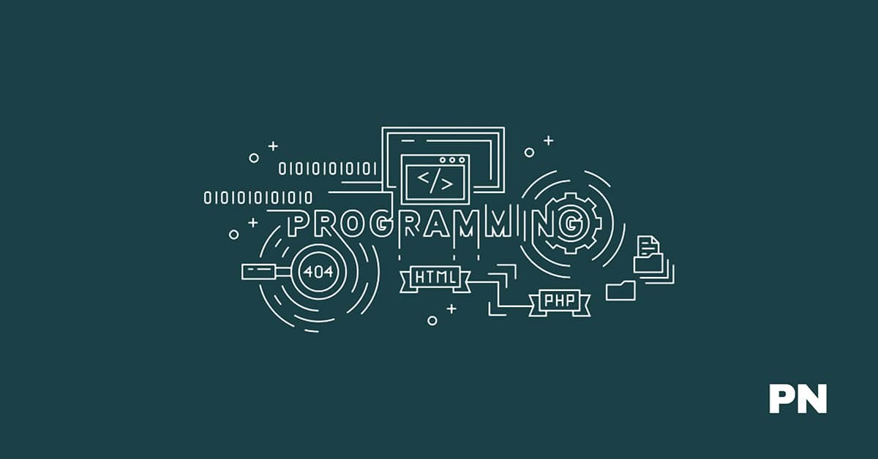

Bite Into Python🐍
Guido Van Rossum

Slide 4
What is Python:
Python is an general purpose, Object-oriented, High-level, Dynamically Typed, Compiled and Interpreted programming language known for its simplicity and readability.
Common Uses of Python:
Web Development: Using frameworks like Django, FastAPI and Flask.
Data Analysis and Visualization: With libraries like Pandas, Matplotlib, and Seaborn.
Artificial Intelligence and Machine Learning: Leveraging tools like TensorFlow, PyTorch, and Scikit-learn.
Automation/Scripting: Automating repetitive tasks using Python scripts.
Game Development: Using libraries like Pygame.
Scientific Computing: Libraries like SciPy and SymPy are used for simulations and computations.
Software Development: For prototyping and backend development.

Slide 5
What is Programming?
What is Programming Language?

Slide 6
What is Programming? : Writing a Program
What is Programming Language? : Is a Collection of Tokens.

Slide 7
Python Tokens:
In Python, tokens are the smallest individual units of the program that have a meaningful role. Python breaks every program into these tokens during the lexical analysis phase.
There are 5 types of Python tokens:
Keywords
Identifiers
Literals
String Literals
Numeric Literals
Boolean Literals
Special Literal (None)
Collection Literals
Operators
Punctuators
Comments

Slide 8
Python Program Execution:
In Python, program execution refers to the process by which the Python interpreter processes the code, executes it, and produces the desired output. Here's a step-by-step explanation of how program execution works in Python:
1. Writing the Python Code
A programmer writes Python code in a .py file using a text editor or an Integrated Development Environment (IDE).
The code typically includes variables, functions, classes, control structures, and logic.

Slide 9
2. Interpreted Language:
Python is an interpreted language, which means the code is executed line-by-line by the Python interpreter rather than being compiled into machine code (like C++ or Java).
This makes Python highly portable, Platform Independent and easy to debug but sometimes slower compared to compiled languages.

Slide 10
3. Execution Process: Python executes programs in the following stages:
a) Parsing:
The Python interpreter reads the source code and checks it for syntax errors. If any syntax errors exist, execution stops, and the interpreter throws an error.
b) Compilation to Bytecode:
If no syntax errors are found, Python compiles the code into bytecode.
Bytecode is a low-level, platform-independent representation of the source code. It is stored in .pyc files (e.g., in the __pycache__ directory).
Compilation is implicit and happens automatically; you don’t need to do it manually.
c) Execution by Python Virtual Machine (PVM):
The bytecode is passed to the Python Virtual Machine (PVM).
The PVM executes the bytecode line by line and performs the corresponding operations on the system.

Slide 11
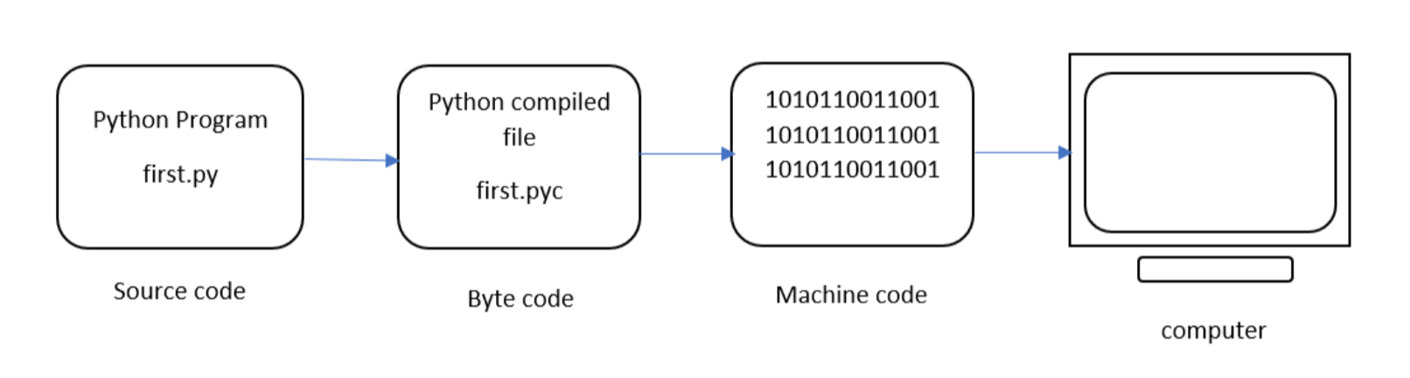
The next step involves converting the byte code (.pyc file) into machine code. This step is necessary as the computer can understand only machine code (binary code). Python Virtual Machine (PVM) first understands the operating system and processor in the computer and then converts it into machine code. Further, these machine code instructions are executed by processor and the results are displayed.
However, the interpreter inside the PVM translates the program line by line thereby consuming a lot of time.

Slide 12
Interpretation in Python
The bytecode produced by the compilation step is executed by the Python Virtual Machine (PVM). The PVM interprets the bytecode line by line and executes it. This is what gives Python its "interpreted" behavior.
Key Points
Python is not a purely compiled language like C or C++, where code is compiled into machine code before execution.
Python is not a purely interpreted language like early versions of BASIC, which execute source code directly without compiling it.
Instead, Python uses a hybrid model: it compiles source code to bytecode (a form of intermediate code), which is then interpreted.

Slide 13
How Python is Compiled and Interpreted:
Python is often described as both a compiled and an interpreted language, depending on how you look at its execution process.
Compilation in Python:
When you run a Python program, it first goes through a compilation step.
The Python interpreter compiles the source code (.py file) into bytecode (a lower-level, platform-independent representation). This bytecode is stored in .pyc files (in the __pycache__ directory).
Note:
This compilation step is implicit and happens behind the scenes.
The bytecode is not directly executed by your machine; it is executed by the Python interpreter.

Slide 14
Parts of Python Programming Language:
Python programming language consists of several essential components and parts that work together to provide its functionality and versatility.
Identifiers
Keywords
Statements and Expressions
Variables
Operators
Precedence and Associativity
Data Types
Indentation
Comments
Program Execution
Reading Input and Print Output

Slide 15
1. Identifiers:
Identifiers in Python are name given to the programming elements such as variables, functions, classes, or other objects. They serve as labels to reference these objects in code.
Python has specific rules and conventions for creating identifiers.
Example for Identifiers: Valid Identifiers:
my_variable
Variable123
_privateVar
MyClass

Slide 16
Rules for Creating Identifiers
1. Allowed Characters:
Identifiers can only contain letters (a-z, A-Z), digits (0-9), and underscores (_).
They cannot start with a digit. For example, 123abc is invalid, but abc123 is valid.
2. Case Sensitivity: Identifiers are case-sensitive. For example, MyVariable and myvariable are treated as distinct identifiers.
3. Keywords: Identifiers cannot be the same as Python's reserved keywords (e.g., if, while, class, def, etc.). Use the keyword module to view the list of reserved keywords in Python
4. Special Characters: Identifiers cannot include special characters like @, $, %, or spaces.
5. Length: Identifiers can be of any length, but it’s good practice to keep them concise and meaningful.
6. Underscore Usage:
A single leading underscore (_var): Used to indicate a private variable (not enforced by Python, but by convention).
Double leading underscores (__var): Used for name mangling in classes to avoid name conflicts in child.
Double underscores at both ends (__init__): Reserved for special methods or magic methods in Python.

Slide 17
Example for Invalid Identifiers:
123abc (Starts with a digit)
my-variable (Contains a hyphen)
class (Reserved keyword)
my variable (Contains a space)

Slide 18
2. Keywords:
Keywords in Python are reserved words that have a specific meaning and purpose in the language. They are part of Python's syntax and cannot be used as identifiers (e.g., variable names, function names, or class names).
Python keywords are case-sensitive and must be used exactly as defined.
Characteristics of Keywords:
Fixed Meaning: The meaning of a keyword is predefined and cannot be changed.
Case-Sensitive: Keywords must be used in lowercase (e.g., if is valid, but If is not).
Reserved: They cannot be used for naming variables, functions, or any other identifiers.

Slide 19
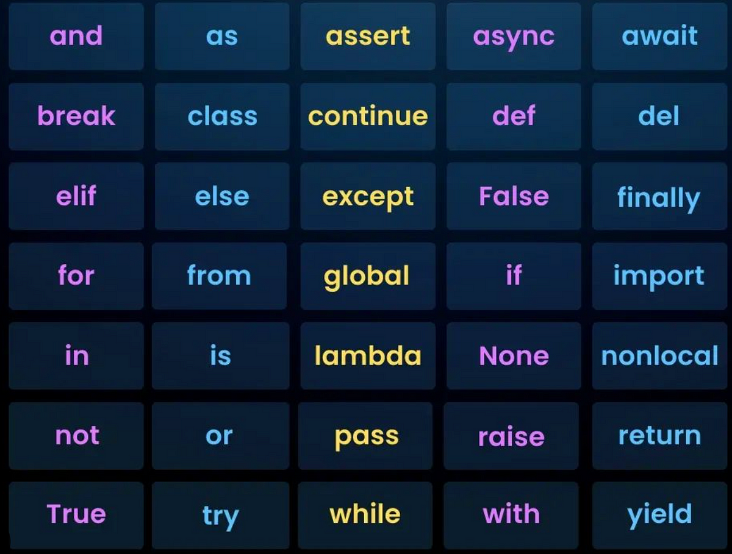
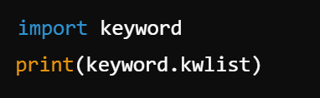
List of Keywords:
Python has a predefined set of keywords. You can get the current list of keywords using the keyword module:

Slide 20
Variables:
In Python, variables are symbolic names that are used to reference objects in memory.
They are essentially labels that point to data stored in memory, enabling you to access and manipulate that data.
Variables are fundamental in programming and are used to store information that can be retrieved or modified during program execution.

Slide 21
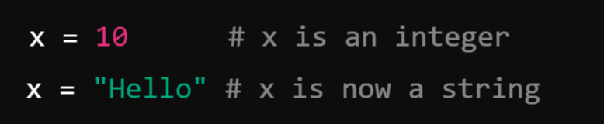
Key Characteristics of Variables in Python:
1. Dynamic Typing:
Python is a dynamically-typed language, meaning you do not need to declare the type of a variable explicitly. The type is inferred based on the value assigned to the variable.
Example:
2. No Explicit Declaration: Variables are created when you assign a value to them as Python is Dynamically Typed Language as compared to C and Java as they are statically Typed Languages.
3. Variable Naming Convention: As Variable is an Identifier, So it should follow the Rules for Creating Identifiers.
4. Memory Management: Python uses a garbage collector to manage memory automatically. Variables point to objects in memory, and when an object is no longer referenced, it is garbage collected.

Slide 22
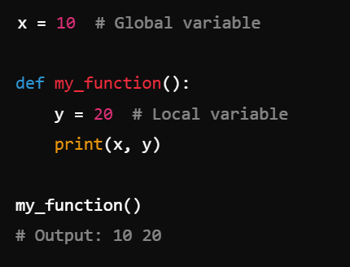
Global and Local Variables:
Global Variables: Defined outside a function and accessible throughout the program.
Local Variables: Defined inside a function and accessible only within that function.
Example:

Slide 23
Comments:
In Python, comments are lines of text within the code that are ignored by the Python interpreter. They are used to explain, document, and improve the readability of the code, making it easier for others (and yourself) to understand what the code does.
As programs get bigger and more complicated, they get more difficult to read. Formal languages are dense, and it is often difficult to look at a piece of code and figure out what it is doing, or why.
For this reason, it is a good idea to add notes to your programs to explain in natural language what the program is doing. These notes are called comments, and they start with the # symbol:

Slide 24
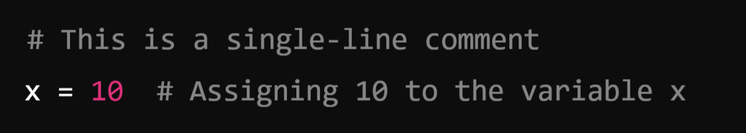
Types of Comments in Python
1. Single-Line Comments:
Begin with a hash symbol (#) and extend to the end of the line.
Used for brief explanations or notes.
Example:

Slide 25
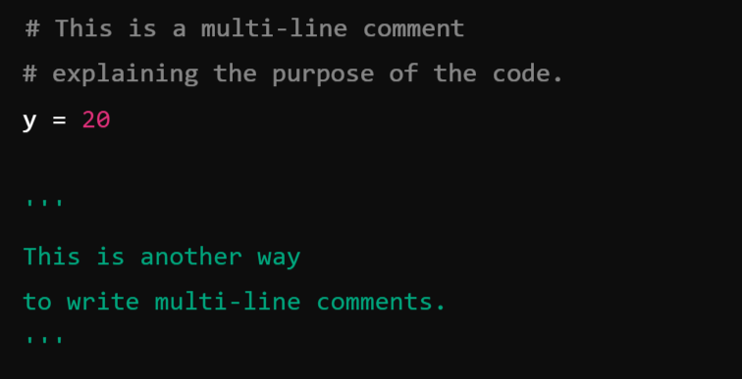
2. Multi-Line Comments:
Python does not have a special syntax for multi-line comments.
Instead, multi-line comments are achieved by using:
Multiple single-line comments.
Triple-quoted strings (''' or """) that are not assigned to any variable.
These are often used for longer explanations or temporary disabling of blocks of code.
Example:

Slide 26
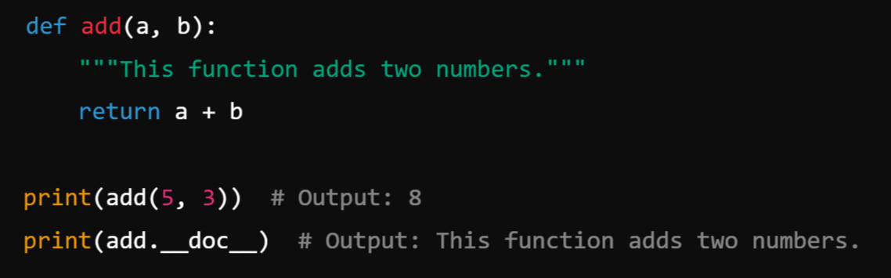
3. Documentation Strings (Docstrings):
Triple-quoted strings (“”” or ‘’’)placed at the beginning of a module, class, or function to describe its purpose.
These are not technically comments but serve a similar purpose.
Accessible via the help() function in Python.
Example:

Slide 27
Operators in Python:
In Python, an operator is a symbol that performs operations on one or more operands. Operands are the values on which the operator operates. Operators are used to manipulate data and variables.
In Python, operators are categorized based on the number of operands they operate on, including:
Unary Operators: An operator which operates on only 1 operand is called Unary.
Binary Operators: An operator which operates on 2 operands is called Binary
Arithmetic Operators
Relational Operators
Logical Operators
Assignment Operators
Bitwise Operators
Ternary Operator: An operator which operates on 3 operand is called Ternary.

Slide 28
Unary Operators: Which operates on only one single Operand.
Operator | Description | Example
+ | Unary positive (identity) | +5 → 5
- | Unary negation | -5 → -5
~ | Bitwise NOT (1's complement) | ~5 → -6
not (It is not symbol but keyword) | Logical negation | not True → False

Slide 29
2. Binary Operators: Operates on two operands
1. Arithmetic Operators: These are used for performing mathematical calculations.
Operator | Name | Example | Description (a = 5 b = 3)
+ | Addition | a + b → 8 | Adds two values
- | Subtraction | a - b → 2 | Subtracts second from first
* | Multiplication | a * b → 15 | Multiplies two values
/ | Division | a / b → 2.5 | Divides first by second
% | Modulus | a % b → 2 | Returns the remainder
** | Exponentiation | a ** b → 125 | Raises first to power of second
// | Floor Division | a // b → 2 | Returns quotient without remainder

Slide 30
2. Relational or Comparison Operators:
Relational operators in Python are used to compare two values and return a boolean result (true or false).
Operator | Name | Example | Description (a = 5 b = 3)
== | Equal to | a == b → False | Checks if values are equal
!= | Not equal to | a != b → True | Checks if values are not equal
> | Greater than | a > b → True | Checks if first is greater
< | Less than | a < b → False | Checks if first is smaller
>= | Greater than or equal | a >= b → True | Checks if first is greater or equal
<= | Less than or equal | a <= b → False | Checks if first is smaller or equal

Slide 31
3. Logical Operators: (Works along with Relational Operator)
Logical operators in Python are used to perform logical operations on boolean expressions. They are commonly used in conditional statements to combine multiple conditions.
Operator | Name | Example | Description (a = 5 b = 3)
and | Logical AND | (a > 1 and b < 5) → True | Returns True if both conditions are True
or | Logical OR | (a > 1 or b > 5) → True | Returns True if one condition is True
not | Logical NOT | not(a > 5) → True | Negates the result of the condition

Slide 32
4. Assignment Operators: These are used to assign values to variables and can combine with arithmetic/bitwise operators.
Operator | Name | Example | Equivalent To
= | Assign or Simple Assignment | a = b | a = b
+= | Add and assign | a += b | a = a + b
-= | Subtract and assign | a -= b | a = a - b
*= | Multiply and assign | a *= b | a = a * b
/= | Divide and assign | a /= b | a = a / b
&= | Bitwise AND and assign | a &= b | a = a & b

Slide 33
5. Bitwise Operators:
Bitwise operators in Python perform bit-level operations on integer types (int, long, short, char, byte). These operators work directly on the binary representation of numbers.
Operator | Name | Example | Description (a = 5 b = 3)
& | Bitwise AND | a & b → 1 | Sets bit to 1 if both bits are 1
` | ` | Bitwise OR | `a
^ | Bitwise XOR | a ^ b → 6 | Sets bit to 1 if bits are different
~ | Bitwise NOT | ~a → -6 | Inverts all bits
<< | Left Shift | a << 1 → 10 | Shifts bits to the left by n places
>> | Right Shift | a >> 1 → 2 | Shifts bits to the right by n places

Slide 34
Truth Table:
&
2. |
3. ~
4. ^
A | B | A & B
0 | 0 | 0
0 | 1 | 0
1 | 0 | 0
1 | 1 | 1
A | !A
0 | 1
1 | 0
A | B | A | B
0 | 0 | 0
0 | 1 | 1
1 | 0 | 1
1 | 1 | 1
A | B | A | B
0 | 0 | 0
0 | 1 | 1
1 | 0 | 1
1 | 1 | 0

Slide 35
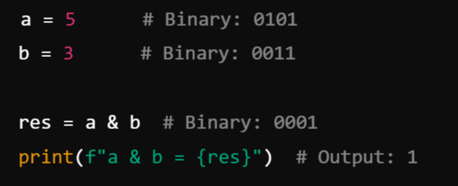
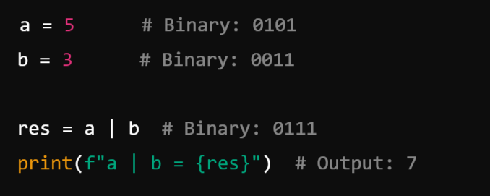
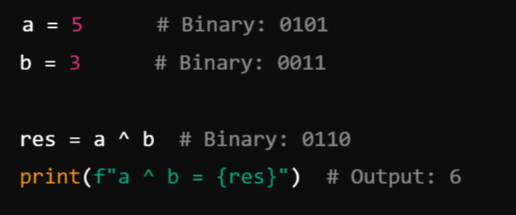
Example:
&
|
^

Slide 36
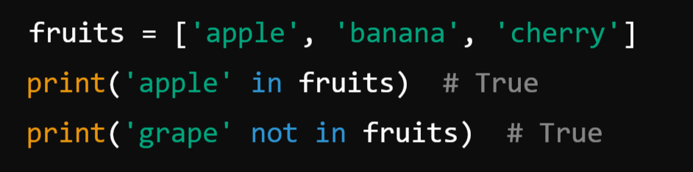
6. Membership Operators: These are used to test membership in sequences (e.g., strings, lists, tuples).
Example:
Operator | Name | Example | Description
in | Membership | 'a' in 'apple' → True | Returns True if value is in the sequence
not in | Not Membership | 'x' not in 'apple' → True | Returns True if value is not in sequence

Slide 37
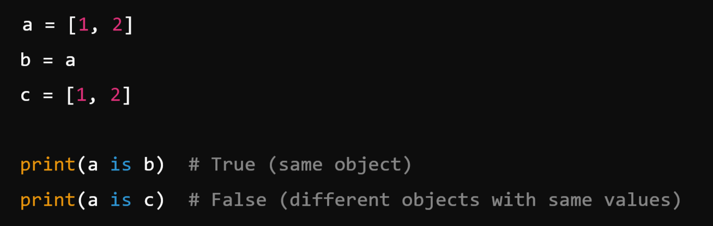
7. Identity Operators: These are used to compare memory locations of two objects.
Example:
Operator | Name | Example | Description
is | Identity | a is b | Returns True if objects are identical
is not | Not Identity | a is not b | Returns True if objects are not identical

Slide 38
Summary:
Category | Examples
Arithmetic | +, -, *, /, %, **, //
Comparison | ==, !=, >, <, >=, <=
Logical | and, or, not
Bitwise | &, `
Assignment | =, +=, -=, *=, /=, &=
Membership | in, not in
Identity | is, is not

Slide 39
3. Ternary Operator
The ternary operator in Python, also known as the conditional operator, is a shorthand for an if-else statement. It has three operands and is used to evaluate a condition and return one of two values, depending on whether the condition is true or false.
Ternary operators operate on three operands. Python supports the ternary operator through a concise if-else conditional expression.
Syntax:
Where,
condition: This is a boolean expression that evaluates to either true or false.
Value_if_true: This is the value returned if the condition is true.
Value_if_false: This is the value returned if the condition is false.

Slide 40
Example:
Condition | Ternary Expression | Result
x > 5 (True) | "Greater" if x > 5 else "Smaller" | Greater
x == 5 (False) | "Equal" if x == 5 else "Not Equal" | Not Equal

Slide 41
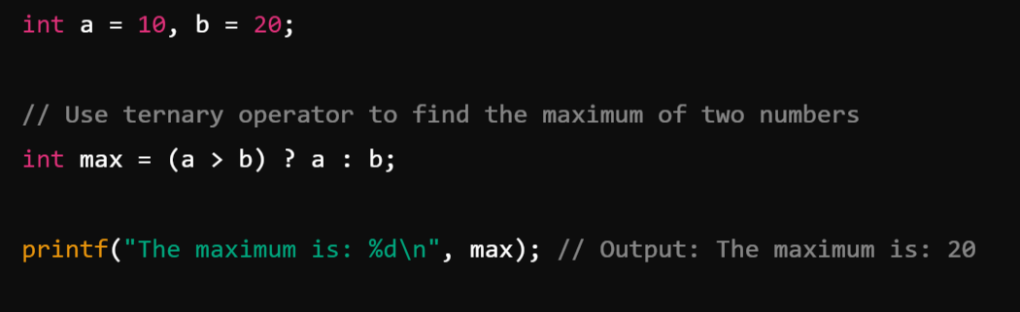
Example: In Java

Slide 42
Operator Hierarchy
Precedence and Associativity

Slide 43
Precedence and Associativity:
Precedence:
Precedence or Hierarchy refers to the order in which operators are evaluated in an expression when there are multiple operators present. So, it determines the order in which operators are evaluated in an expression. Operators with higher precedence are evaluated before operators with lower precedence.
Associativity:
Associativity defines the direction in which operators of the same precedence level are evaluated in an expression. If operators have the same precedence, their associativity determines the order of evaluation.
Associativity can be either:
Left-to-Right Associativity: Operators are evaluated from left to right. This is common for most operators.
For example, in the expression a - b - c, subtraction is evaluated as (a - b) - c.
Right-to-Left Associativity: Operators are evaluated from right to left. This is less common and is typically seen with assignment (=) and ternary (?:) operators.
For example, in the expression a = b = c, the assignment is evaluated as a = (b = c).

Slide 44
Precedence and Associativity:
Precedence | Operators | Description | Associativity
1 | () | Parentheses | Left-to-right
2 | ** | Exponentiation | Right-to-left
3 | +x, -x, ~x | Unary operators (positive, negative, bitwise NOT) | Right-to-left
4 | *, /, //, % | Multiplication, division, floor division, modulus | Left-to-right
5 | +, - | Addition, subtraction | Left-to-right
6 | <<, >> | Bitwise shift operators | Left-to-right
7 | & | Bitwise AND | Left-to-right
8 | ^ | Bitwise XOR | Left-to-right
9 | ` | ` | Bitwise OR
10 | ==, !=, >, <, >=, <= | Comparison operators | Left-to-right
11 | not | Logical NOT | Right-to-left
12 | and | Logical AND | Left-to-right
13 | or | Logical OR | Left-to-right
14 | =, +=, -=, *=, /=, //=, %= | Assignment operators | Right-to-left

Slide 45
Example:
result = 10 + 20 * 2 / 4; // Result will be 20
result = (10 + 20) * (2 / 4); // Result will be 15
result = 10 > 5 == 5 < 3;
result = (10 == 10) & (5 < 3);
int a = 10;
int b = 5;
int result = a += b * 2;

Slide 46
Data Types:
In Python, data types represent the kind or type of value stored in a variable. Python is Dynamically Typed Language, meaning variables don’t need explicit type declarations—they infer the type from the assigned value.
In Python, data types can be broadly categorized into:
Primitive or Built-In (Basic) types
Non-Primitive (Derived or Composite) types

Slide 47
1. Primitive Data Types (Basic Types):
Primitive data types are the most basic, built-in types that serve as the building blocks for data manipulation. These are immutable (cannot be changed after creation use id(var_name) to check).
These Includes:
Numeric or Number Type
int
float
Text Type (String)
Boolean Type (True or False)
None Type (None)

Slide 48
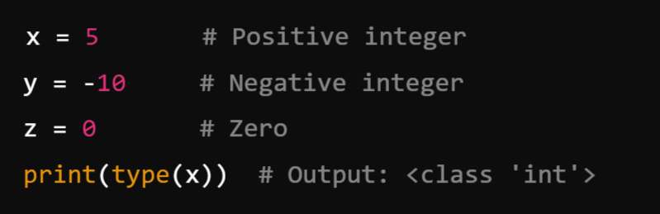
1. Numeric Types: Python provides 3 basic types for working with numbers:
a) int (Integer)
Represents whole numbers (positive, negative, or zero) without fractional parts.
Unlimited precision (size only limited by memory).
Examples:

Slide 49
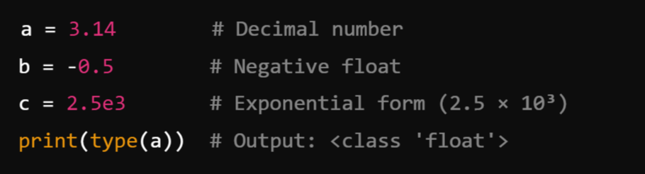
b) float (Floating-Point Number):
Represents numbers with a decimal point or in exponential notation (scientific notation).
Approximation to real numbers, with a fixed precision.
Examples:

Slide 50
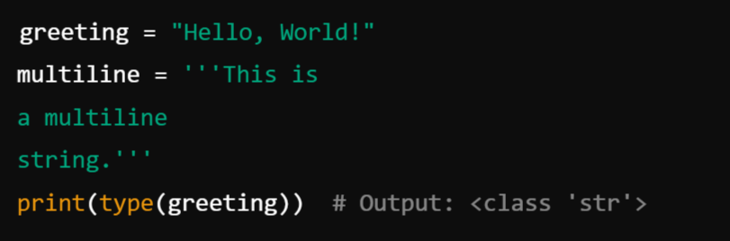
2. Text Type (String or Char): str
Represents sequences of characters (text data).
Enclosed in single ('), double ("), or triple quotes (''' or """).
Examples:

Slide 51
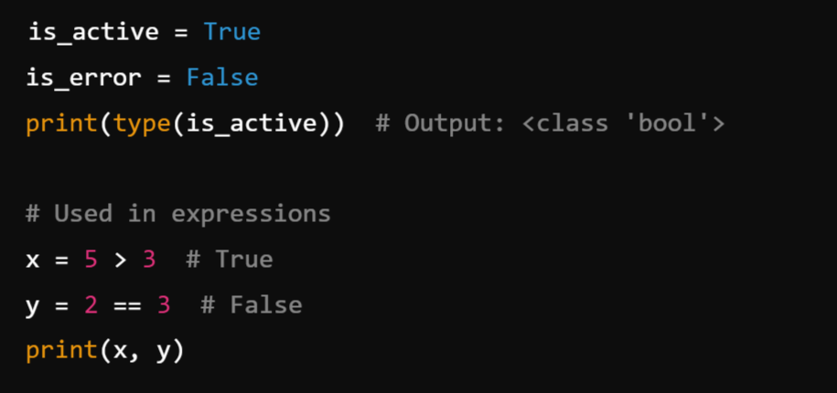
3. Boolean Type (bool):
Represents logical values: True or False.
Often used in conditional statements and logical operations.
Examples:

Slide 52
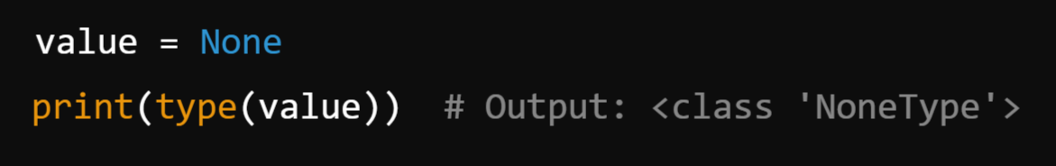
4. None Type
Represents the absence of a value or a null value.
Denoted by the keyword None.
Examples:

Slide 53
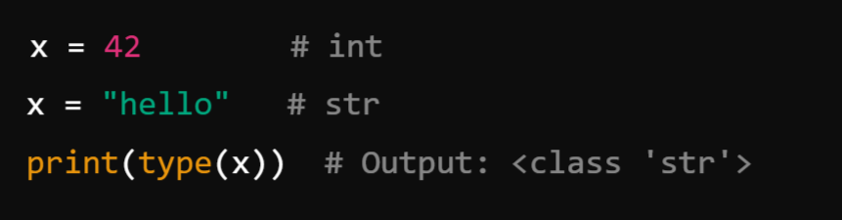
Key Characteristics of Primitive Types:
Immutable: Once created, their value cannot be changed (e.g., changing a string or number creates a new object in memory).
Type Inference: Python automatically detects the type when a value is assigned to a variable.
Dynamic Typing: Variables can change type during execution

Slide 54
Strings:
In Python, a string (str) is a sequence of characters used to store and manipulate text. Strings are one of the most commonly used data types in Python and are enclosed in single quotes ('), double quotes ("), or triple quotes (''' or """).
Features of String:
A sequence of characters.
Immutable (cannot be changed after creation).
Indexed by integers starting from 0.

Slide 55
Creating and Storing Strings:
Python, strings are sequences of characters used to store text data. They are immutable, meaning they cannot be changed after creation.
Python provides multiple ways to create, manipulate, and store strings.
1. Creating Strings:
Strings in Python can be created using:
Single quotes (')
Double quotes (")
Triple quotes (''' or """) (for multi-line strings)

Slide 56
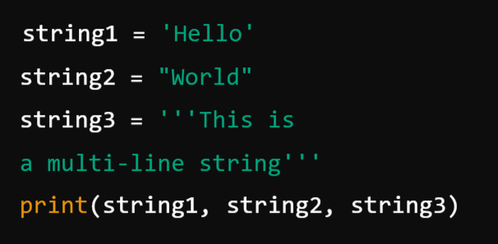
Example: Creating Strings

Slide 57
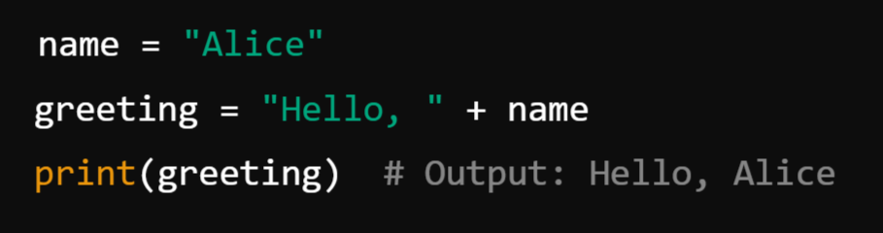
2. Storing Strings in Variables:
Strings are stored as objects in memory and assigned to variables.

Slide 58
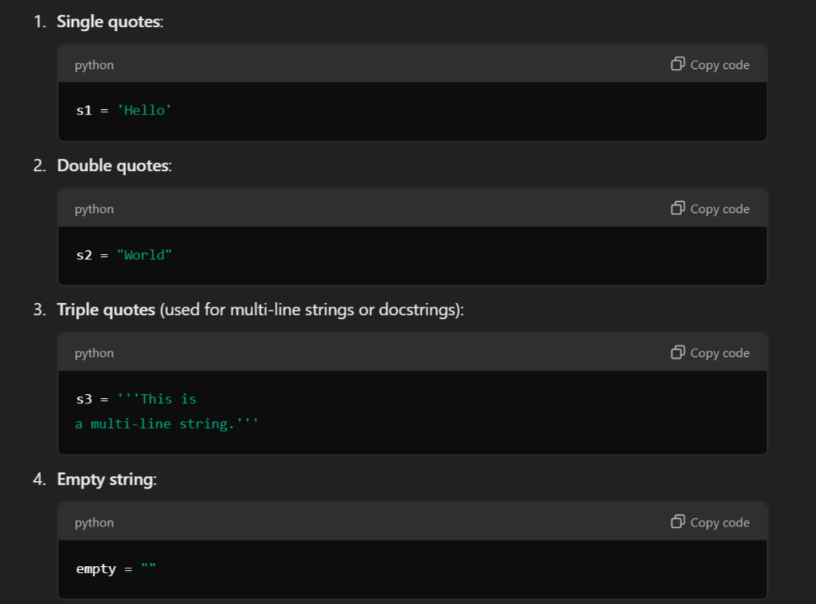
Creating Strings:

Slide 59
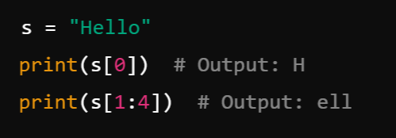
Example:

Slide 60
Basic String Operations:
Python provides various operations for working with strings, including concatenation, repetition, slicing, searching, and formatting. Strings in Python are immutable, meaning their values cannot be changed after creation.
String Concatenation (+)
String Repetition (*)
String Indexing ([]):
String Slicing ([:])
Checking Substring (in, not in)

Slide 61
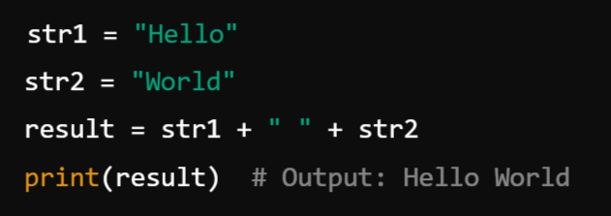
1. String Concatenation (+):
Concatenation means joining two or more strings.
✔️ Use Case: Combining names, sentences, or messages.

Slide 62
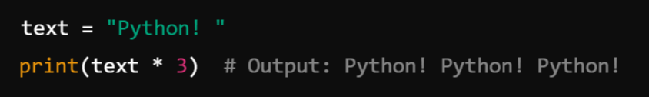
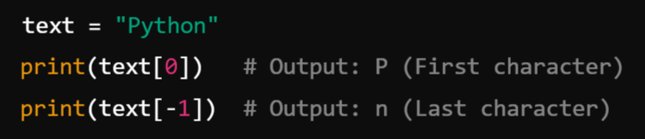
2. String Repetition (*): Repeats a string multiple times.
3. String Indexing ([]): Accessing Characters in String by Index Number
Each character in a string has an index starting from 0.

Slide 63
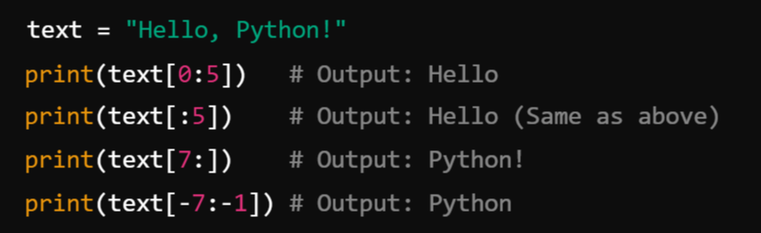
4. String Slicing ([:]) :
Extracts a substring from a string.

Slide 64
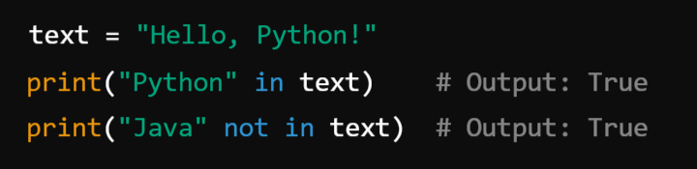
5. Checking Substring (in, not in): Check if a substring exists within a string.

Slide 65
6. String Methods: Python provides several built-in methods for manipulating strings.
Method | Description | Example
len() | Returns string length. | len("Python") → 6
lower() | Converts to lowercase. | "PYTHON".lower() → "python"
upper() | Converts to uppercase. | "python".upper() → "PYTHON"
strip() | Removes spaces from both ends. | " hello ".strip() → "hello"
replace() | Replaces a substring. | "hello world".replace("world", "Python") → "hello Python"
split() | Splits string into a list. | "apple,banana".split(",") → ['apple', 'banana']
join() | Joins list elements into a string. | "-".join(['apple', 'banana']) → "apple-banana"
find() | Returns index of substring. | "hello".find("l") → 2
startswith() | Checks if string starts with a substring. | "hello".startswith("he") → True
endswith() | Checks if string ends with a substring. | "hello".endswith("lo") → True

Slide 66
Built-in String Handling Functions:
Python provides several built-in string handling functions that help in performing various operations on strings.
len()
lower() & upper()
strip(), lstrip(), rstrip()
Replace()
split() & join()
find() & index()
startswith() & endswith()
isalpha(), isdigit(), isalnum()
title() & capitalize()

Slide 67
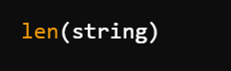
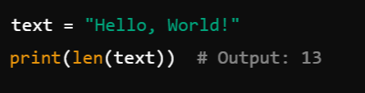
len() – Get the Length of a String:
Syntax:
Example:

Slide 68
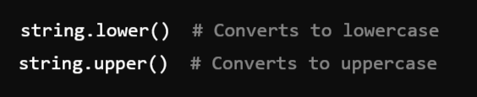
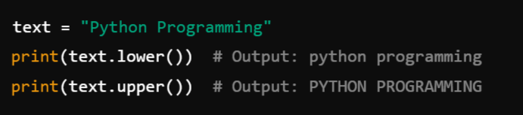
2. lower() & upper() – Convert Case
Syntax:
Example:

Slide 69
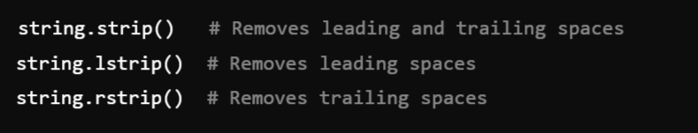
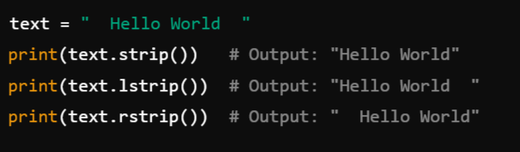
3. strip(), lstrip(), rstrip() – Remove Whitespaces
Syntax:
Example:

Slide 70
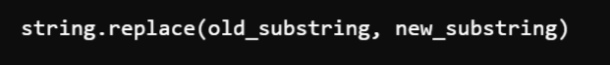
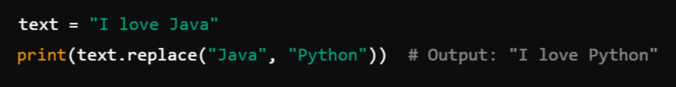
4. replace() – Replace a Substring
Syntax:
Example:

Slide 71
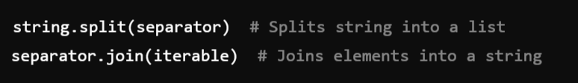
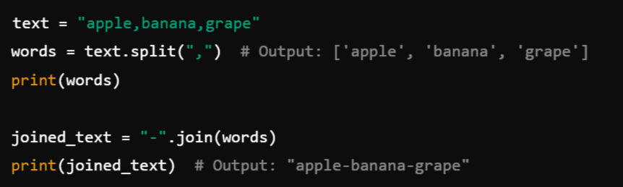
5. split() & join() – Splitting and Joining Strings
Syntax:
Example:

Slide 72
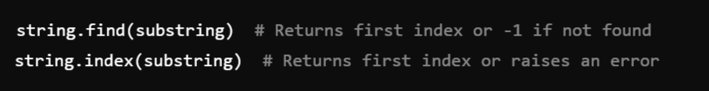
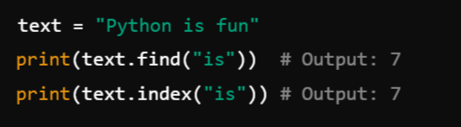
6. find() & index() – Find Substring Position
Syntax:
Example:

Slide 73
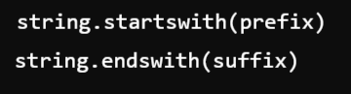
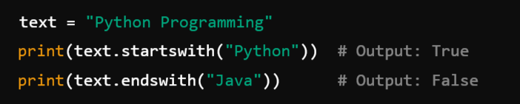
7. startswith() & endswith() – Check String Start/End
Syntax:
Example:

Slide 74
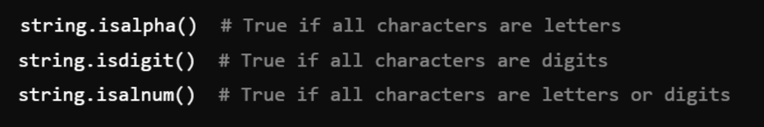
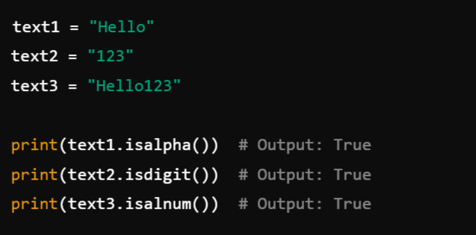
8. isalpha(), isdigit(), isalnum() – Character Checks
Syntax:
Example:

Slide 75
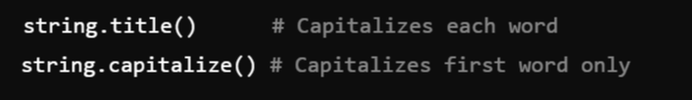
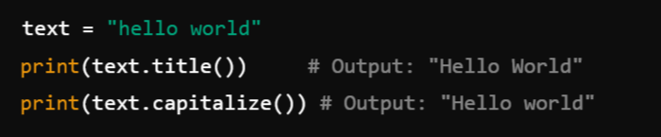
9. title() & capitalize() – Format String
Syntax:
Example:

Slide 76
Method | Syntax | Description | Example
len() | len(string) | Returns the length of the string (number of characters). | len("Hello") → 5
lower() | string.lower() | Converts all characters to lowercase. | "Hello".lower() → "hello"
upper() | string.upper() | Converts all characters to uppercase. | "hello".upper() → "HELLO"
strip() | string.strip() | Removes leading and trailing spaces. | " hello ".strip() → "hello"
lstrip() | string.lstrip() | Removes leading spaces (left side). | " hello".lstrip() → "hello"
rstrip() | string.rstrip() | Removes trailing spaces (right side). | "hello ".rstrip() → "hello"
replace() | string.replace(old, new) | Replaces occurrences of a substring with another. | "hello world".replace("world", "Python") → "hello Python"
split() | string.split(separator) | Splits the string into a list based on a separator (default is space). | "apple,banana,grape".split(",") → ["apple", "banana", "grape"]
join() | separator.join(iterable) | Joins elements of an iterable into a string using the specified separator. | ",".join(["apple", "banana", "grape"]) → "apple,banana,grape"
find() | string.find(substring) | Returns the index of the first occurrence of a substring, or -1 if not found. | "hello world".find("world") → 6
index() | string.index(substring) | Returns the index of the first occurrence of a substring, raises an error if not found. | "hello world".index("world") → 6
startswith() | string.startswith(substring) | Checks if the string starts with a specific substring (returns True/False). | "hello world".startswith("hello") → True
endswith() | string.endswith(substring) | Checks if the string ends with a specific substring (returns True/False). | "hello world".endswith("world") → True
isalpha() | string.isalpha() | Returns True if all characters are letters (A-Z, a-z), False otherwise. | "Hello".isalpha() → True, "Hello123".isalpha() → False
isdigit() | string.isdigit() | Returns True if all characters are digits (0-9), False otherwise. | "123".isdigit() → True, "12a3".isdigit() → False
isalnum() | string.isalnum() | Returns True if all characters are alphanumeric (letters + digits), False otherwise. | "Hello123".isalnum() → True, "Hello 123".isalnum() → False
title() | string.title() | Converts the first letter of each word to uppercase. | "hello world".title() → "Hello World"
capitalize() | string.capitalize() | Converts the first letter of the string to uppercase, rest to lowercase. | "hello WORLD".capitalize() → "Hello world"

Slide 77
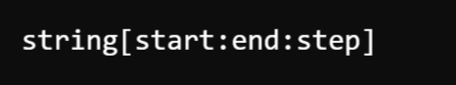
String Slicing and Joining:
1. String Slicing in Python:
String slicing is the process of extracting a portion (substring) of a string using indexing and range notation.
Syntax of Slicing:
start: The starting index (inclusive).
end: The stopping index (exclusive).
step: The step (interval) for slicing (default is 1).

Slide 78


1.1 Basic Slicing:
1.2 Negative Indexing: Python allows negative indices to count from the end of the string.

Slide 79

1.3 Using Step in Slicing: The step argument allows skipping characters.
✔️ Use Case: Extracting specific parts of a string, reversing a string, skipping characters.

Slide 80

2. String Joining in Python:
String joining is the process of combining multiple strings (or list elements) into a single string using a separator.
Syntax of join():
separator: The string used to join elements.
iterable: The sequence (e.g., list, tuple) of strings.

Slide 81


2.1 Joining a List into a String:
2.2 Joining with a Different Separator:

Slide 82

2.3 Joining Characters in a String:
✔️ Use Case: Converting lists into readable strings, formatting output.

Slide 83
Formatting Strings:
String formatting allows you to insert variables, format values, and structure text dynamically in Python.
Python provides multiple ways to format strings:
Using format() Method
Using f-strings (Python 3.6+)
Using % Operator (Old Method)

Slide 84

1. Using format() Method:
The .format() method allows inserting values into placeholders {} inside a string.
1.1 Basic Formatting:

Slide 85


1.2 Using Positional Arguments:
1.3 Using Named Arguments:

Slide 86

2. Using f-strings (Python 3.6+):
The f-string (f"") is the most modern and efficient way to format strings in Python.
2.1 Basic f-strings:

Slide 87


2.2 Performing Calculations:
2.3 Formatting Numbers:

Slide 88

3. Using % Operator (Old Method):
This method is similar to C-style string formatting.
3.1 Basic Formatting

Slide 89
Format Specifier | Meaning
%s | String
%d | Integer
%f | Float

Slide 90


List
Tuple
Set
Dict

Slide 91
2. Non-Primitive Data Types or Collections (Composite Types):
Non-Primitive Data Types (Composite Types) in Python are more complex and built using primitive types. They allow for grouping, organizing, and manipulating multiple values. These types can hold collections of values or structured data, making them essential for handling real-world problems.
These Includes:
Sequence Types
list
tuple
Range
2. Set Types
set
Frozenset
3. Mapping Types (dict)

Slide 92
1. Sequence Types: Sequences are ordered collections of items. Python provides several sequence types:
1) list:
A mutable, ordered collection, and can have duplicate items.
Can hold elements of different data types (Heterogeneous).
Syntax: Enclosed in square brackets [].
Creating a List:

Slide 93

Example:
✔️ Lists can store different data types.

Slide 94


2. Accessing List Elements:
2.1 Using Indexing ([]):
2.2 Using Negative Indexing:

Slide 95
Basic List Operations in Python:
Python lists support various operations, including addition, multiplication, slicing, iteration, and built-in functions.
Concatenation (+)
Repetition (*)
Membership (in and not in)
Indexing and Slicing

Slide 96


1. Concatenation (+):
You can combine two lists using the + operator.
Syntax:
Example:
✔️ Creates a new list without modifying original lists.

Slide 97


2. Repetition (*):
You can repeat a list multiple times using the * operator.
Syntax:
Example:

Slide 98


3. Membership (in and not in): Check if an element exists in a list.
Syntax:
Example:

Slide 99


4. Indexing and Slicing: Retrieve specific elements or sublists.
Syntax:
Example:

Slide 100
Built-In Functions Used on Lists: Functions that Python provides globally, not tied to a specific list object.
Python provides various built-in functions to perform operations on lists efficiently. Below is a comprehensive explanation of the most commonly used functions with syntax and examples.

Slide 101


1. len() - Get Length of List: Returns the number of elements in a list.
Syntax:
Example:

Slide 102


2. max() - Get Maximum Value: Returns the largest element from a list of numbers or strings.
Syntax:
Example:

Slide 103


3. min() - Get Minimum Value: Returns the smallest element in a list.
Syntax:
Example:

Slide 104


4. sum() - Get Sum of List: Returns the sum of all numeric elements in a list.
Syntax:
Example:
✔ Works only with numeric values.

Slide 105

5. sorted() - Sort List Without Modifying Original : Returns a sorted copy of the list.
Syntax: ✔ Unlike sort(), it does not modify the original list.
Example:

Slide 106
Summary
Function | Description | Example
len() | Returns the number of elements in the list | len([1, 2, 3]) → 3
max() | Returns the largest element | max([5, 3, 8]) → 8
min() | Returns the smallest element | min([5, 3, 8]) → 3
sum() | Returns the sum of all elements | sum([1, 2, 3]) → 6
sorted() | Returns a sorted copy of the list | sorted([3, 1, 2]) → [1, 2, 3]

Slide 107
List Methods
Functions that are built into the list object.

Slide 108
List Methods: These methods belong to List Object ( Class )
These are functions that belong to the list object.
They are called using dot notation (list.method()).
Many of them modify the list in place.
Examples: append(), insert(), remove(), sort(), reverse(), etc.
Built-in Functions for Lists:
These are general-purpose functions in Python that work with lists but are not specific to them.
They take the list as an argument.
They do not modify the list in place (except sorted()).
Examples: len(), sum(), max(), min(), sorted(), etc.

Slide 109


1. append() - Adds a single item to the end of the list.
Syntax:
Example:

Slide 110


2. insert() -Inserts an element at a given index without replacing existing elements.
Syntax:
Example:

Slide 111


3. extend() - Add Multiple Elements to the End
Extends the list by appending elements from another iterable (e.g., list, tuple, set).
Syntax
Example:

Slide 112


4. remove() -Removes the first matching element in the list.
Syntax
Example:
✔ Raises an error if the value is not found.

Slide 113

5. list.pop() - Removes an element at a given index and returns it.
Syntax
Example:

Slide 114


6. clear() - Remove All Elements. Clears the list, making it empty.
Syntax:
Example:

Slide 115

7. index() - Returns the index of the first occurrence of a value.
Syntax
Example:
✔ Raises an error if the value is not found.

Slide 116


8. count() - Counts how many times a value appears in the list.
Syntax
Example:

Slide 117

9. sort() - Sort the List in Ascending or Descending Order
Sorts the list in place (modifies the original list).
Syntax
Example:

Slide 118


10. reverse() - Reverses the elements in the list.
Syntax:
Example:

Slide 119
Method | Description | Example
append() | Adds an item at the end | list.append(4)
insert() | Inserts an item at a specific index | list.insert(1, "a")
extend() | Adds multiple elements from an iterable | list.extend([5, 6])
remove() | Removes the first occurrence of a value | list.remove(2)
pop() | Removes and returns an element | list.pop(1)
clear() | Removes all elements | list.clear()
index() | Returns the index of a value | list.index(3)
count() | Counts occurrences of a value | list.count(2)
sort() | Sorts the list in ascending order | list.sort()
reverse() | Reverses the list order | list.reverse()
copy() | Creates a copy of the list | new_list = list.copy()

Slide 120
Tuples in Python:
A tuple is an immutable (unchangeable) ordered collection of elements in Python. It allows storing multiple values in a single variable.
Characteristics of Tuples:
Ordered – Tuples maintain the order of elements.
Immutable – Once created, elements in a tuple cannot be modified, added, or removed.
Allows Duplicates – Tuples can have duplicate values.
Heterogeneous – A tuple can store different data types (integers, floats, strings, etc.).

Slide 121

Creating a Tuple:
Tuples are created using parentheses () or the tuple() constructor.

Slide 122

Accessing Elements in a Tuple:
Tuples support indexing and slicing just like lists.

Slide 123

Tuple Unpacking:
Tuples support unpacking, which allows storing tuple values in separate variables.
When to Use Tuples?
When you need to store data that should not change (e.g., days of the week, coordinates, database records).
When you want faster access to elements compared to lists.

Slide 124
Built-In Methods for Tuple:
Tuples in Python have only a few built-in methods since they are immutable (cannot be modified).
The two most commonly used tuple methods are:
count(value) – Returns the number of occurrences of a value in the tuple.
index(value, start, end) – Returns the first index of a value in the tuple.

Slide 125

1. count(value):
This method returns the number of times a specified value appears in the tuple.
Example:
💡 Use case: When you need to check the frequency of an element in a tuple.

Slide 126

2. index(value, start, end):
This method returns the first index where the specified value is found in the tuple.
Example:
Optional parameters:
start – The index where the search should begin.
end – The index where the search should stop.

Slide 127

Example with start and end parameters:
💡 Use case: When you need to find the position of an element in a tuple.

Slide 128

3) range
Represents a sequence of numbers.
Commonly used in loops.
Syntax: range(start, stop, step).
Examples:

Slide 129
2. Set Types: Sets are unordered collections of unique elements.
1. Sets : {}
A set is an unordered, mutable, and unique collection of elements in Python. It is useful when you need to store distinct values and perform mathematical operations like union, intersection, and difference.
Characteristics of Sets:
Unordered – The elements in a set do not maintain any specific order.
Unique Elements – Sets do not allow duplicate values.
Mutable – You can add or remove elements from a set.
Heterogeneous – A set can store different data types (integers, floats, strings, etc.).
Unindexed – You cannot access set elements using an index.

Slide 130

2) frozenset:
Immutable version of a set.
Syntax: Created using frozenset() function.
Examples:

Slide 131

Creating a Set:
Sets are defined using curly braces {} or the set() constructor.

Slide 132

Accessing Elements in a Set:
Since sets are unordered, they do not support indexing or slicing.
However, you can iterate over a set using a loop:

Slide 133


Adding Elements to a Set:
You can use the add() method to insert a single element into a set.
To add multiple elements, use update():

Slide 134

Removing Elements from a Set:
remove(value) – Removes the element. Raises an error if the element is not found.
discard(value) – Removes the element. Does not raise an error if the element is not found.
pop() – Removes a random element.
clear() – Removes all elements from the set.

Slide 135

Set Operations:
1. Union (| or union()): Combines elements from two sets (removes duplicates).

Slide 136


2. Intersection (& or intersection()): Returns elements that exist in both sets (Common Element from both the sets).
3. Difference (- or difference()): Returns elements that exist only in the first set.

Slide 137
When to Use Sets?
When you need unique elements (e.g., removing duplicates from a list).
When performing set operations like union, intersection, or difference.
When checking membership (x in set is faster than x in list).

Slide 138
Mapping Types: Dictionaries(Dict) in Python:
Mappings store data in key-value pairs. A dictionary (dict) is an unordered, mutable, and key-value based data structure in Python. It is widely used for storing and retrieving data efficiently.
Syntax: Enclosed in curly braces {}.
Characteristics of Dictionaries:
Key-Value Pairs – Each element consists of a key and a value.
Keys Must Be Unique – Duplicate keys are not allowed.
Mutable – You can modify, add, or remove key-value pairs.
Unordered (Before Python 3.7) – In Python 3.7+, dictionaries maintain insertion order.
Fast Lookup – Dictionary lookup (dict[key]) is faster than searching in a list.

Slide 139

Creating a Dictionary:
Dictionaries are created using curly braces {} or the dict() constructor.

Slide 140

Accessing Dictionary Elements: You can access dictionary values using keys.
🔹 get() is preferred over dict[key] because it avoids errors if the key does not exist.

Slide 141

Adding & Updating Dictionary Elements:
Dictionaries are mutable, so you can add or update key-value pairs.

Slide 142
Removing Dictionary Elements:
Method | Description
pop(key) | Removes and returns the value of the key
popitem() | Removes and returns the last inserted key-value pair (Python 3.7+)
del dict[key] | Deletes a specific key-value pair
clear() | Removes all elements from the dictionary

Slide 143

Example:

Slide 144


Looping Through a Dictionary:
Loop Through Keys:
Loop Through Value:

Slide 145

3. Loop Through Key-Value Pairs:

Slide 146
When to Use Dictionaries?
When you need fast lookups by key (O(1) time complexity).
When storing key-value data (e.g., JSON responses, configurations).
When working with structured data like user details, product catalogs, etc.

Slide 147

The type( ) Function and Is Operator:
type() Function in Python:
The type() function in Python is a built-in function used to determine the type of an object. It helps identify what kind of data type an object belongs to, such as int, float, str, list, etc.
Syntax:
object: The input whose type is to be determined.

Slide 148

How type() Works:
The function returns the class type of the object. Python uses classes to define its data types, so type() effectively tells you the class to which the object belongs.
Example:

Slide 149

is Operator in Python:
The is operator in Python is used to compare the identity of two objects. It checks whether two variables refer to the same object in memory, not just if their values are equal.
Syntax:
Returns True if both x and y refer to the same object in memory.
Returns False otherwise

Slide 150
Key Points:
1. Identity Comparison:
The is operator checks the identity of the objects using their memory addresses (object IDs).
2. Difference from ==:
is compares the identity of objects.
== compares the values of objects.
Objects with the same value may not have the same identity.
3. Singletons:
The is operator is commonly used to check if an object is a singleton like None

Slide 151

Example:
1. Comparing Identity:

Slide 152

2. Using is with Singletons:
A Singleton is a design pattern that ensures a class has only one instance throughout the program, and provides a single global point of access to it.
None is a singletone as internally, Python creates only one instance of NoneType.
Whenever you write None anywhere in your code, it always points to the same object.

Slide 153

3. Objects with Same Value but Different Identity:

Slide 154

Object Caching in Python:
For some immutable objects (like small integers and strings), Python caches objects to optimize memory usage. For these objects, is might return True for equal values because the same object is reused.
Example:

Slide 155
Indentation in Python:
Indentation in Python is a fundamental part of its syntax. Unlike many other programming languages that use braces {} or keywords like end to define blocks of code, Python uses indentation to represent the hierarchy and grouping of code.
Why Indentation is Important in Python?
Defines Code Blocks:
Indentation is used to define blocks of code, such as the body of loops, functions, conditionals, and classes.
Without proper indentation, Python will throw an error.
2. Improves Readability:
It ensures that code is visually clear and easier to read.
3. Mandatory: Indentation is not optional. Python does not use braces {} to indicate blocks, so proper indentation is necessary.

Slide 156
Example for Indentation:

Slide 157
Type Conversions:
Type conversion, also known as Type Casting, is the process of converting one data type into another. Python provides two main ways to perform type conversions:
1. Implicit Type Conversion (Type Coercion):
Python automatically converts one data type to another when it is safe to do so.
2. Explicit Type Conversion:
The programmer manually converts one data type into another using type conversion functions.

Slide 158

1. Implicit Type Conversion
Python performs implicit conversions during operations where data types are compatible, and no data loss occurs. This usually happens with numeric types like int, float, and complex.
Example:

Slide 159
2. Explicit Type Conversion:
Explicit type conversion is done using Python’s built-in functions. The programmer decides the target type.
Common Conversion Functions:
Function | Converts x To
int(x) | Integer
float(x) | Floating-point number
str(x) | String
list(x) | List
tuple(x) | Tuple
set(x) | Set
dict(x) | Dictionary
bool(x) | Boolean
complex(x) | Complex number

Slide 160


Examples of Explicit Type Conversion
Integer to String:
b) String to Integer:

Slide 161


c) List to Set:
d) Tuple to List:

Slide 162


e) Float to Integer:
f) String to Float:

Slide 163
Summary Table of Conversions:
Original Type | Converted To | Conversion Function | Example
int | float | float(x) | float(5) → 5.0
float | int | int(x) | int(3.14) → 3
list | set | set(x) | set([1, 2, 2]) → {1, 2}
tuple | list | list(x) | list((1, 2)) → [1, 2]
str | int | int(x) | int("123") → 123
str | float | float(x) | float("3.14") → 3.14
list | tuple | tuple(x) | tuple([1, 2]) → (1, 2)

Slide 164

Reading Input in Python:
In Python, reading input refers to the process of taking data (usually from the user) during program execution. Python provides a built-in function called input() for this purpose.
The input() Function Basic Syntax:
prompt: An optional string that is displayed to the user as a message before taking input.
Return Value: The function always returns the input as a string.

Slide 165

How It Works:
The program pauses and waits for the user to type something.
The user types a value and presses Enter.
The input() function captures the value as a string and stores it in a variable.
Example: Basic Input

Slide 166


2. Input as Numbers:
Since input() returns a string, you need to convert it to the appropriate data type (e.g., int, float) for numeric operations.
3. Input with Multiple Values: You can take multiple inputs in one line by splitting the input string using the split() method.

Slide 167
Print Output:
In Python, printing output refers to displaying text, variables, or results of computations to the console or terminal. The print() function is used for this purpose.
Syntax of print():
Parameters:
*objects: The values or objects you want to display. Multiple items can be separated by commas.
sep: The string inserted between multiple objects (default is a space ‘ ').
end: The string appended at the end of the output (default is a newline '\n').
file: The output stream (default is sys.stdout, which prints to the console).
flush: A boolean specifying whether to flush the output buffer (default is False).

Slide 168


Example:
Printing Strings:
Printing Variables:

Slide 169


Advanced Features of print()
1. Printing Multiple Values
You can print multiple values by separating them with commas. By default, they are separated by a space.
2. Custom Separator (sep): You can change the separator between multiple values using the sep parameter.

Slide 170


3. Custom End (end) : By default, print() ends with a newline. You can change this using the end parameter.
Output:

Slide 171
Control Flow Statements: (Control the Flow of Execution)
Control flow statements in Python determine the order in which the code is executed. These statements help the program decide whether to execute a particular block of code, repeat a block of code, or jump between blocks based on conditions.
Types of Control Flow Statements
Conditional Statements (Decision-Making)
if
if-else
if-elif-else
Nested if
Looping Statements
for loop
while loop
Jump Statements
break
continue
pass

Slide 172
1. Conditional Statements (Decision-Making):
Conditional statements in Python allow the program to make decisions based on specific conditions. These statements execute certain blocks of code only when specified conditions are met. The main decision-making statements in Python are:
if Statement
if-else Statement
if-elif-else Statement
Nested if Statement

Slide 173


1. if Statement ( Simple If):
The if statement executes a block of code to True. only when the given condition evaluates
Syntax:
Example:
The condition x > 5 evaluates to True, so the indented block is executed.

Slide 174

Simple If Flow Chart

Slide 175


2. if-else statement:
The if-else statement provides two blocks of code: one that executes if the condition is true and another that executes if the condition is false.
Syntax:
Example:
The condition x > 5 evaluates to False, so the else block is executed.

Slide 176

if-else Flow Chart

Slide 177

3. if-elif-else Statement:
The if-elif-else allows for multiple conditions to be evaluated sequentially. The first condition that evaluates to true will have its corresponding block executed, and the rest of the ladder will be skipped. If none of the conditions are true, the else block (if present) will be executed.
Syntax:

Slide 178

Example:

Slide 179

4. Nested if statement:
Nested if statements allow an if statement to be placed inside another if statement. This allows for more complex decision-making processes where multiple conditions must be true for a block of code to execute.
Syntax:

Slide 180

Example:

Slide 181


One-Liner if Statement: Python allows simple if statements to be written in a single line.
Example:
One-Liner if-else Statement (Ternary Operator): The if-else statement can also be written as a one-liner using the ternary operator.
Syntax:
Example:

Slide 182
2. Looping Statements:
Looping statements in Python allow you to execute a block of code multiple times, either for a specific number of iterations or until a certain condition is met.
Python provides two main types of loops:
for Loop
while Loop
Additionally, Python supports jump statements (break, continue, and pass) to control the flow within loops.

Slide 183



1. for loop:
The for loop provides a concise way of writing the loop structure. It is used when the number of iterations is known advance or beforehand.
The for loop is used to iterate over a sequence (e.g., list, tuple, dictionary, string, or range). It executes the block of code once for each element in the sequence.
Syntax:
Example: a) Iterating Over a List: Output:

Slide 184




b) Using range(): The range() function generates a sequence of numbers.
Output:
c) Iterating Over a String:
Output:

Slide 185

for Loop Flow Chart:

Slide 186


2. while loop:
The while loop continually executes a block of code as long as a specified condition is true. The condition is checked before the execution of the loop body, making it a pre-test loop.
The while loop is used when the number of iterations is not known in advance, but the condition is checked before the loop body executes.
Syntax:
Example: Print Num from 0-4:

Slide 187


Using a while Loop with else:
The else block in a while loop executes if the loop completes normally (i.e., not terminated by a break).
Example: Output:

Slide 188


Slide 189


Loops with else
Both for and while loops can have an optional else block that executes if the loop finishes without encountering a break.

Slide 190
3. Jump Statements:
Jump statements in Python are used to control the flow of loops by altering their default behavior.
Python provides the following jump statements:
break Statement
continue Statement
pass Statement
These statements allow you to exit a loop, skip an iteration, or do nothing, respectively.

Slide 191

1. break Statement:
The break statement is used to exit a loop prematurely, regardless of the loop's condition. Once the break statement is executed, the loop terminates, and control moves to the code following the loop.
Syntax:

Slide 192



Examples:
Breaking a for Loop: Output:
Breaking a while Loop:

Slide 193

2. continue Statement:
The continue statement is used to skip the rest of the code in the current iteration and proceed to the next iteration of the loop. The loop does not terminate but continues with the next iteration.
Syntax:

Slide 194



Example:
Skipping an Iteration in a for Loop:
Output:
b) Skipping an Iteration in a while Loop:

Slide 195

3. pass Statement: (Or …)
The pass statement is a placeholder that does nothing when executed. It is often used when a statement is syntactically required but no action is desired.
Syntax:

Slide 196


Examples
Using pass in an if Statement:
Using pass in a Loop:

Slide 197
Sequences:
In Python, a sequence is an ordered collection of items, where each item is indexed by an integer. Sequences allow you to store multiple values and access them using their position (index).
Python provides several built-in sequence types, such as:
strings
lists
tuples
ranges.

Slide 198
Strings:
In Python, a string (str) is a sequence of characters used to store and manipulate text. Strings are one of the most commonly used data types in Python and are enclosed in single quotes ('), double quotes ("), or triple quotes (''' or """).
Features of String:
A sequence of characters.
Immutable (cannot be changed after creation).
Indexed by integers starting from 0.

Slide 199
Creating Strings:

Slide 200
Example:

Slide 201
Built-in String Handling Functions:
Python provides several built-in string handling functions that help in performing various operations on strings.

Slide 202
len() – Get the Length of a String:
Syntax:
Example:

Slide 203
2. lower() & upper() – Convert Case
Syntax:
Example:

Slide 204
3. strip(), lstrip(), rstrip() – Remove Whitespaces
Syntax:
Example:

Slide 205
4. replace() – Replace a Substring
Syntax:
Example:

Slide 206
5. split() & join() – Splitting and Joining Strings
Syntax:
Example:

Slide 207
6. find() & index() – Find Substring Position
Syntax:
Example:

Slide 208
7. startswith() & endswith() – Check String Start/End
Syntax:
Example:

Slide 209
8. isalpha(), isdigit(), isalnum() – Character Checks
Syntax:
Example:

Slide 210
9. title() & capitalize() – Format String
Syntax:
Example:

Slide 211
Built-In Functions:
Python provides a set of built-in functions that are always available without the need for importing any modules. These functions help with various tasks such as mathematical operations, type conversion, input/output handling, and more.
Input/Output Functions
Type Conversion Functions
Mathematical Functions
Sequence & Iterable Functions
Object & Variable Handling Functions:
File Handling Functions
Functional Programming Functions

Slide 212

Input/Output Functions:
Example:
Function | Description
print() | Outputs text to the console.
input() | Takes user input as a string.

Slide 213

2. Type Conversion Functions:
Example:
Function | Description
int() | Converts to an integer.
float() | Converts to a floating-point number.
str() | Converts to a string.
bool() | Converts to a boolean value.
list() | Converts to a list.
tuple() | Converts to a tuple.
set() | Converts to a set.
dict() | Converts to a dictionary.

Slide 214

3. Mathematical Functions:
Example:
Function | Description
abs(x) | Returns the absolute value of x.
pow(x, y) | Returns x raised to the power y (x^y).
round(x, n) | Rounds x to n decimal places.
sum(iterable) | Returns the sum of elements in an iterable.
min(iterable) | Returns the minimum element.
max(iterable) | Returns the maximum element.

Slide 215

4. Sequence & Iterable Functions:
Example:
Function | Description
len() | Returns the length of an object.
sorted(iterable) | Returns a sorted list.
reversed(iterable) | Returns a reversed iterator.
enumerate(iterable) | Returns an iterator with index-value pairs.
zip(iter1, iter2, ...) | Combines iterables into pairs.

Slide 216

5. Object & Variable Handling Functions:
Example:
Function | Description
id(obj) | Returns the unique memory ID of an object.
type(obj) | Returns the type of an object.
isinstance(obj, class) | Checks if obj is an instance of class.
hash(obj) | Returns the hash value of an object.

Slide 217

6. File Handling Functions:
Example:
Function | Description
open(filename, mode) | Opens a file in a given mode (r, w, a, rb, etc.).
close() | Closes the opened file.

Slide 218

7. Functional Programming Functions:
Example:
Function | Description
map(func, iterable) | Applies func to each item in iterable.
filter(func, iterable) | Filters elements based on func.
lambda | Defines an anonymous function.

Slide 219
Functions In Python:
A function in Python is a block of reusable code that performs a specific task. Functions help to break programs into smaller, modular, and manageable parts.
A function is a self-contained programming segment which is used to perform specific and well-defined task.
📌 Types of Functions in Python:
Built-in Functions – Predefined in Python (e.g., print(), len(), type(), input(), etc.).
User-defined Functions – Created by the user for custom operations.
Lambda Functions – Anonymous (one-line) functions.

Slide 220

🔹 Function Definition and Calling a Function:
✅ Function Definition: Implementation of a Function
In Python, a function is defined using the def keyword.
Syntax:

Slide 221


✅ Calling a Function:
A function is called using its name followed by parentheses ().
Syntax:
🔹 Example: Simple Function:

Slide 222

The return Statement and void Function:
In Python, functions can either return a value using the return statement or not return anything (void function).
✅ 1. The return Statement:
The return statement is used inside a function to send a value back to the caller.
Once return is executed, the function stops further execution and exits.
Syntax:

Slide 223

Example:
📌 Key Points About return:
✔ A function can return any data type (int, float, string, list, tuple, dict, etc.).
✔ A function can return multiple values as a tuple.
✔ If no return is specified, the function returns None.

Slide 224

Function Returning Multiple Values: Python allows returning multiple values using tuples.

Slide 225

✅ 2. Void Function (Function Without return):
A void function does not return a value. Instead, it performs an action like printing or modifying global variables.
Example: Void Function

Slide 226
Since greet() has no return statement, calling it will not return any value, it just prints output.
📌 Key Points About Void Functions:
✔ A void function does not return any value (returns None by default).
✔ It is used for side effects like printing, modifying global variables, writing to a file, etc.

Slide 227
Scope and Lifetime of Variables:
In Python, variables are the containers for storing data values. Unlike other languages like C/C++/JAVA, Python is not “statically typed”. We do not need to declare variables before using them or declare their type. A variable is created the moment we first assign a value to it.
Python Scope variable
The location where we can find a variable and also access it if required is called the scope of a variable.
Python Local variable
Local variables are those that are initialized within a function and are unique to that function. It cannot be accessed outside of the function.

Slide 228
Scope and Lifetime of Variables:
✅ 1. Scope of Variables:
The scope of a variable defines where it can be accessed in a program. Python has different types of scopes:
📌 Types of Variable Scope:
Local Scope – Accessible only inside the function where it is defined.
Enclosing Scope – Available inside a nested function.
Global Scope – Available throughout the program.
Built-in Scope – Available everywhere (e.g., print(), len()).

Slide 229

🔹 1. Local Scope:
A local variable is declared inside a function and is only accessible within that function.
Example:
📌 Note: The variable x is only accessible inside my_function(). If you try to access it outside, Python will throw an error.

Slide 230

🔹 2. Global Scope:
A global variable is declared outside any function and is accessible throughout the program.
Example:
📌 Note: y is a global variable, so it can be accessed both inside and outside the function.

Slide 231

🔹 3. Enclosing (Nonlocal) Scope:
In nested functions, a variable declared in the outer function can be accessed inside the inner function. This is called the enclosing scope.
Example:

Slide 232

Output:
📌 Note: The nonlocal keyword allows modifying the variable from the enclosing scope.

Slide 233

🔹 4. Built-in Scope:
Python provides many built-in functions and variables, available everywhere.
Example:
Here, len() is a built-in function that can be accessed anywhere in the program.

Slide 234
✅ 2. Lifetime of a Variable:
The lifetime of a variable is the period or time during which it exists in memory.
📌 Key Points About Lifetime:
✔ Local variables exist only while the function executes.
✔ Global variables exist as long as the program runs.
✔ When a function ends, local variables are destroyed.

Slide 235

🔹 Example: Lifetime of a Local Variable:

Slide 236

Default Parameters:
In Python, default parameters allow you to define function parameters with default values. This means that if a value is not provided for that parameter when calling the function, the default value is used.
Syntax:
param1=value1: This means param1 has a default value of value1.
If the argument for param1 is not provided during the function call, it will take value1 as the default.

Slide 237

Example 1: Using Default Parameters:
If greet() is called without an argument, it uses "Guest" as the default.
If an argument is provided, it replaces the default.

Slide 238

Example 2: Multiple Default Parameters:
The default exponent is 2, but it can be overridden.

Slide 239

Rules for Default Parameters:
Default parameters must come after non-default parameters:

Slide 240

2. Mutable default values (like lists or dictionaries) can cause unexpected behavior:
This happens because the default list is shared across function calls.

Slide 241

To avoid this, use None as the default and create a new list inside the function.

Slide 242

Keyword Arguments in Python:
In Python, keyword arguments (also called named arguments) allow you to pass arguments to a function using the parameter name instead of relying on their position. This makes function calls more readable and flexible.
Syntax: You explicitly specify the parameter name when passing arguments.

Slide 243

Example 1: Using Keyword Arguments:
The order of arguments doesn’t matter when using keyword arguments.

Slide 244


Example 2: Mixing Positional and Keyword Arguments:
Positional arguments must appear before keyword arguments.

Slide 245

Example 3: Using Default Parameters with Keyword Arguments:
The animal_type parameter has a default value, but we can override it using a keyword argument.

Slide 246

*args and **kwargs:
Python provides *args and **kwargs to handle variable-length arguments in functions. These allow functions to accept any number of arguments without explicitly defining them.
1. *args (Non-Keyword Arguments)
*args allows you to pass a variable number of positional arguments to a function.
*args collects all positional arguments into a tuple.
Syntax:

Slide 247

Example 1: Using *args:

Slide 248

Example 2: Mixing *args with Regular Arguments:
The first argument (message) is required, but *names can take multiple values.

Slide 249

2. **kwargs (Keyword Arguments):
**kwargs allows you to pass a variable number of keyword arguments (key-value pairs) to a function.
**kwargs collects keyword arguments into a dictionary.
Syntax:

Slide 250

Example:

Slide 251

Example 4: Mixing Regular Arguments, *args, and **kwargs

Slide 252
Where,
greeting is a required parameter.
*args collects extra positional arguments into a tuple.
**kwargs collects extra keyword arguments into a dictionary.

Slide 253

What are Command Line Arguments?
Command line arguments are inputs passed to a Python script when executing it from the command line or terminal. These arguments allow users to provide input dynamically without modifying the script.
Accessing Command Line Arguments:
Python provides the sys module to access command line arguments using sys.argv.
Syntax:
sys.argv is a list where:
sys.argv[0] is the script name.
sys.argv[1], sys.argv[2], etc., are the arguments passed.

Slide 254

Example 1: Printing Command Line Arguments:
Create a Python script named script.py:

Slide 255


Run it from the terminal:
Output:

Slide 256


Example 2: Using Arguments in a Program:
Create a script add_numbers.py:
Run it in the terminal:

Slide 257
Commonly Used Modules:
Python provides a rich standard library with built-in modules for various tasks like file handling, system operations, web requests, and data processing.
Most commonly used modules:
sys (System-Specific Operations)
os (Operating System Interface)
datetime (Date and Time Handling)
math (Mathematical Functions)
random (Generating Random Numbers)
re (Regular Expressions)
json (Handling JSON Data)

Slide 258

1. sys (System-Specific Operations):
Used for interacting with the Python runtime and command-line arguments.
Example:
✔️ Use Cases: System info, exiting scripts, handling command-line arguments.

Slide 259

2. os (Operating System Interface):
Provides functions to interact with the operating system, such as working with files, directories, and environment variables.
Example:
✔️ Use Cases: File handling, directory operations, environment variables.

Slide 260

3. datetime (Date and Time Handling):
Handles dates, times, and time zones.
Example:
✔️ Use Cases: Formatting dates, time calculations, timestamps.

Slide 261

4. math (Mathematical Functions):
Provides mathematical operations like square root, logarithms, and trigonometric functions.
Example:
✔️ Use Cases: Calculations, trigonometry, statistics.

Slide 262

5. random (Generating Random Numbers):
Useful for generating random numbers, selecting random choices, and shuffling data.
Example:
✔️ Use Cases: Simulations, games, data shuffling.

Slide 263

6. re (Regular Expressions):
Provides pattern matching for text processing.
Example:
✔️ Use Cases: String validation, pattern matching, text parsing.

Slide 264

7. json (Handling JSON Data):
Used for working with JSON (JavaScript Object Notation) data.
Example:

